Slide 1
Vehicle Dynamics and Simulation
Introduction
Modelling and Simulation
Dr B Mason

Slide 2
TTC066 Overview
Modelling and Simulation
Differential Equations
Numerical Integration
Linearity and State Space
Ride Dynamics
Eigenvalues and Eigenvectors
Drivetrain Dynamics (MB)
Engine Modelling
Drivetrain Modelling
Parameter Tuning
Vehicle and Engine Testing
MIRA preparation and experimentation
Computer Based Test (40%)
MIRA Coursework (60%)

Slide 3
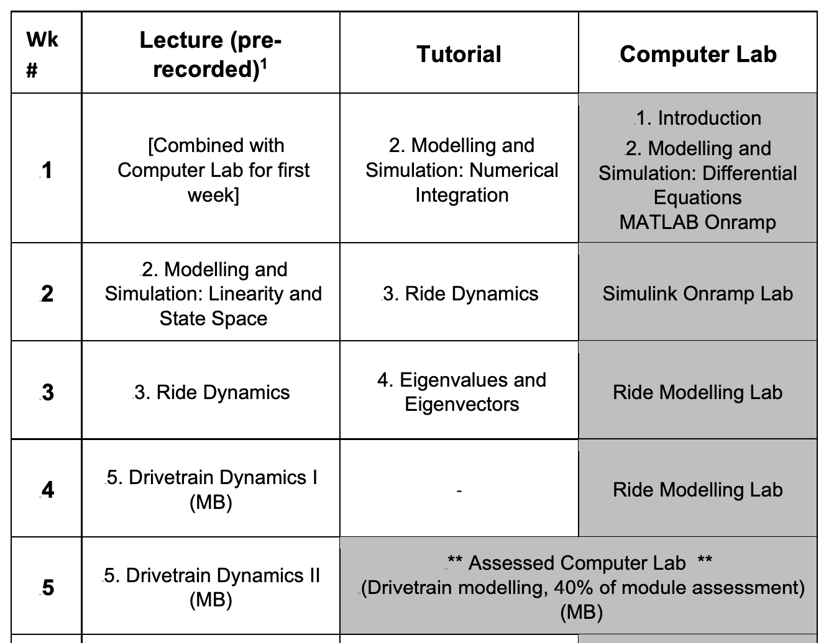
Timetable (first half)

Slide 4
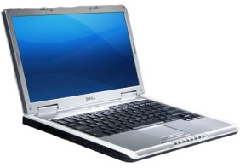
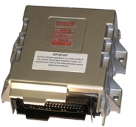
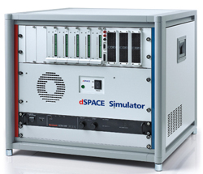
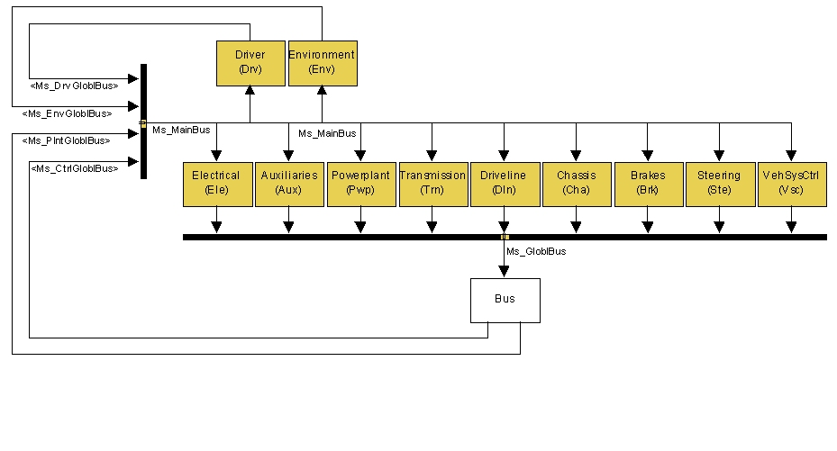
Overview
Model based development for vehicle systems.
What is it?
How it is used for vehicle development.
SiL, HiL & RCP
The various steps of the ‘controller’ development
Real time simulation
Concluding remarks

Slide 5
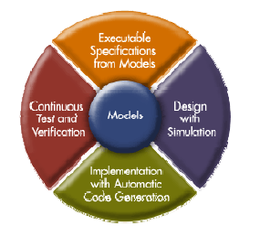
Definitions
Simulation based design/development
Covers all use of dynamic (time varying) models for hardware and software development/optimisation/testing.
Plant & controller
Plant = controlled hardware
Controller = control (embedded) hardware + control algorithm.

Slide 6
Features of SBD
Dynamic model employed for defining engineering specifications (executable – it can be run), design, simulation (early prototyping), prototype development, integration, etc
Model forms the engineering specification.
More specific/descriptive
Engineers can interact with the model
Model can be used for testing
Model is refined/improved as the process is undertaken.

Slide 7
Why use SBD?
Optimise design
Reduce weight
Improve controller
Minimise emissions / weight / energy use
Comprehensive testing before production
Greater test coverage
Evaluate concepts
Reduce time to market & costs associated with development.

Slide 8
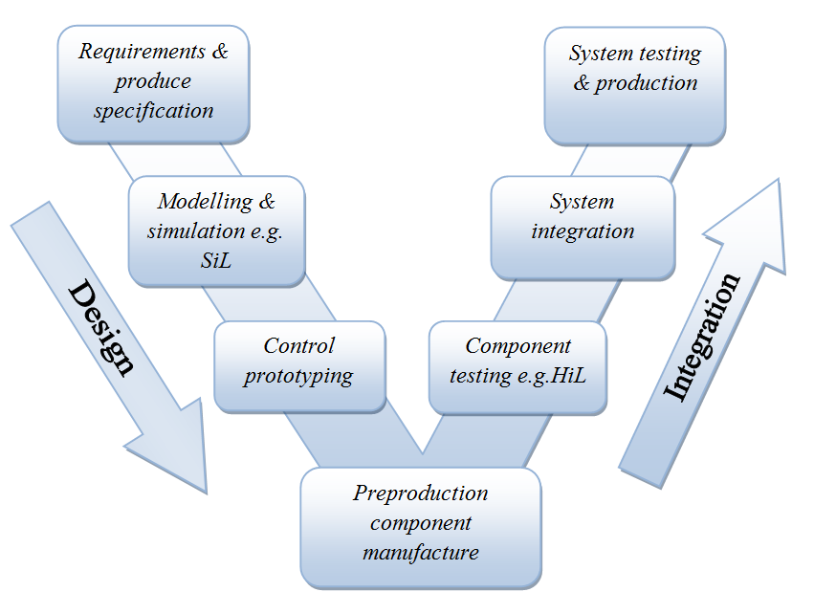
Simulation based design
A model serves as the definition of the system.
Real time simulation techniques are used SiL/HiL/CiL.
More hardware is included ‘in Loop’ as further fidelity increase is required/for integration.

Slide 9
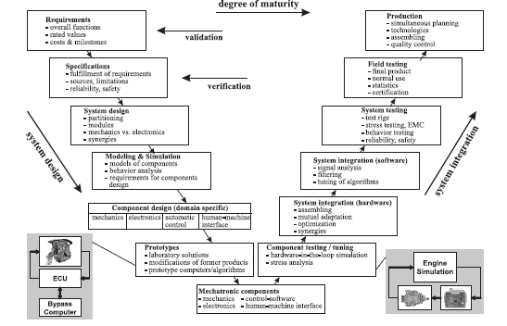
Design process

Slide 10
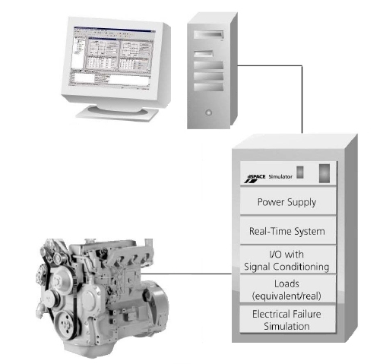
Real time Simulation for Controls Development
Identify
the System
Model
Development
Code
Generation
Interfacing
Simulation
and
Testing
Purpose of study/selection of hardware.
Realtime models cycle time typically 1 msec consider overruns and queuing.
Real Time Workshop generates C-code for the realtime platform.
Model-hardware interaction i.e. delays in data exchange.
Interface using breakout box or other connector.
Notes:
Once the system to be studied/simulated has been determined the process of identifying that which is to be hardware and that which is to be simulated by the model is undertaken. A suitable realtime model of the part of the system to be simulated is created.
Real time models can differ but not always from offline models. As mentioned previously at the very least a realtime model must be capable running such that 1 sec simulation time is equivalent to 1 second of realtime. Cycle times of typically 1msec are required for automotive applications but this can differ for example if the system is highly dynamic or stiff. Delays in transmission of data must be taken into account by the model as well as mechanisms of data exchange.
Once the model is completed c-code is generated for the target real time computer. If the c-code is generated by the user there is no need for a model. However in most cases c-code is generated automatically. The most popular means by which this is done is by use of mathworks real time workshop.
i/o of the system is through a hardware interface that may provide some level of signal conditioning. The use of a breakout box may be required for certain failure simulations such as in ecu testing where looking at shorts, miswiring and other physically based connection fauilures.
Finally simulation is undertaken, because the simulation is run in real time there is the possibility for user interaction. Simulations may be scripted i.e. run automatically which allows the possibility of 24hr testing.
This system (on the rhs) shows an example of hardware in the loop otherwise in this case known as engine in the loop. The real time system provides the power supply which can simulate a real battery and has the capability of multiple voltages i.e. 12, 24 and 48v. In reality this system would require the use of a dyno to provide a load upon the engine. If this is part of the hardware loop the possibility of simulating the response of a real engine in a software or modelled engine is possible.
This is the subject of a case study that we will now look at. The case study concerns the realtime simulation of an automotive powertrain that includes the engine.

Slide 11
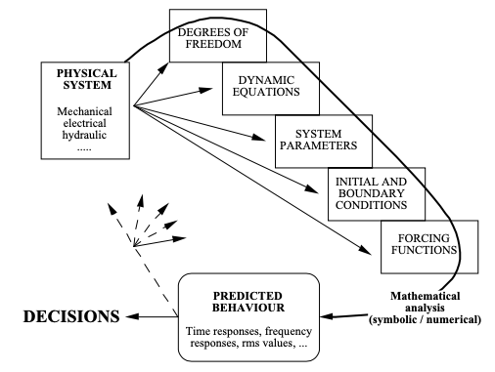

System Modelling

Slide 12
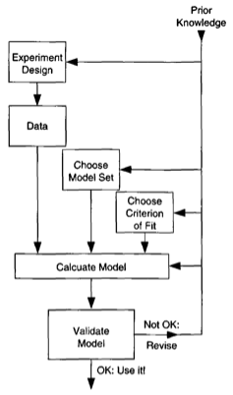
System Identification
Source: Ljung, System Identification
System identification is the process by which a system is described in terms of equations
Empirical models – make use of test data.
Physical models – make use of prior system knowledge and established physics
Both require some prior knowledge to determine the model mathematical structure and parameters

Slide 13
Concluding Remarks
Realtime simulation one second simulation = one second reality. Hardware/user/environment interaction.
Automotive realtime use increasing, controls development (ECU), component testing, pre-calibration/calibration, failure testing.
Reduced time to market and development costs. Increased inter design group interaction at early stages. Testing prior/parallel to full prototype development.
Notes:
Once the model is completed interfaces with hardware may be inserted using blocks from the target library. The target is the realtime computer upon which the model will run. In this particular case there is no interaction with a real physical system the model will be run in realtime but not connected. An example of the connection blocks is shown on the right.

Slide 14
Actions before lecture on Thursday
Read Chapter 1 of Lennart Ljung’s System Identification Theory for the User.
Review previous MATLAB notes
Register and make a start on Matlab Onramp Course - https://tinyurl.com/vdsmatlabonramp

